Slide 1

vSRX on AWS Transit Gateway Services

Slide 2
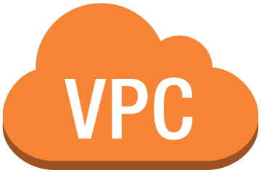

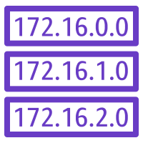



vSRX Transit GW – Cloud Security
A
B
C
Security Services VPC
Ingress RT
vSRX
vSRX
AWS Transit
Gateway
Egress RT
vSRX - L4/L7

Slide 3
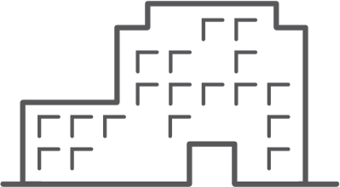


vSRX Transit GW – Hybrid Cloud Security
A
B
C
Security Services VPC
Ingress RT
Corporate Data Center
Juniper SRX Series NGFW
vSRX
vSRX
AWS Transit
Gateway
vSRX - L4/L7
Egress RT

Slide 4
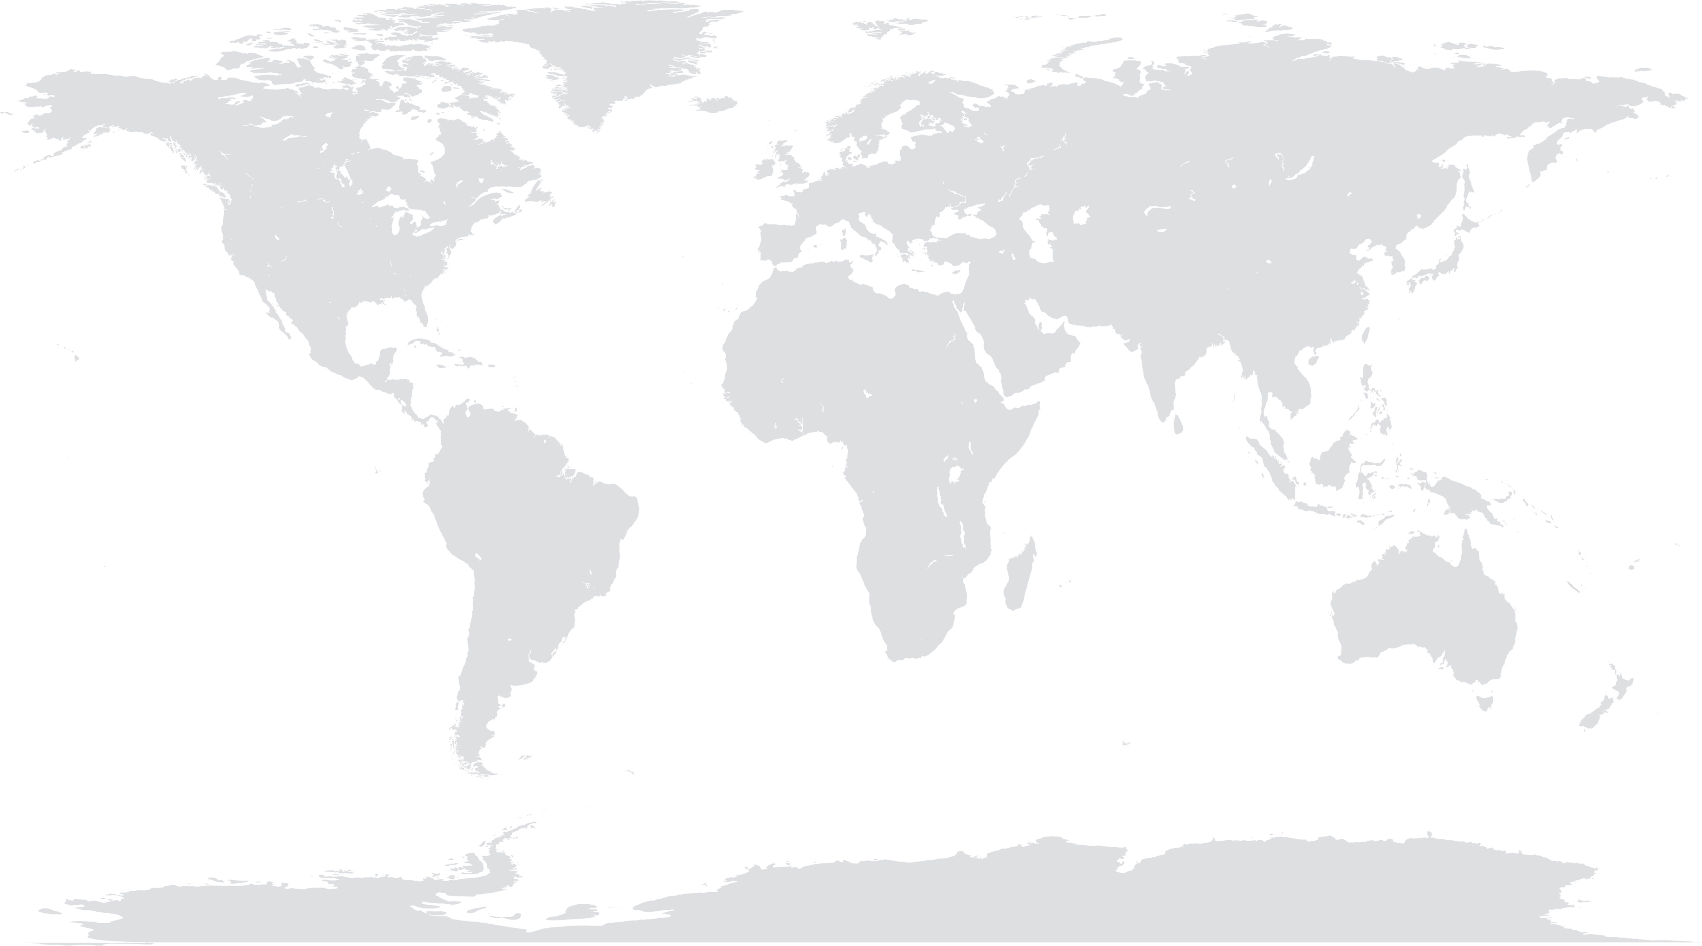
vSRX Transit GW – Inter-Region Transit Security
US-West-1
EU-Central-1
AP-Southeast-1
A
A
A
A
A
A
C
B
C
C
B
B
B
B
B
AWS Transit
Gateway
AWS Transit
Gateway
AWS Transit
Gateway
AWS Transit
Gateway
AWS Transit
Gateway
AWS Transit
Gateway
Security Services VPC
vSRX
vSRX
vSRX - L4/L7

Slide 5
vSRX Transit GW – Inter-Region Transit Security
US-West-1
EU-Central-1
AP-Southeast-1
A
A
A
A
A
A
C
B
C
C
B
B
B
B
B
AWS Transit
Gateway
AWS Transit
Gateway
AWS Transit
Gateway
AWS Transit
Gateway
AWS Transit
Gateway
AWS Transit
Gateway
Security Services VPC
Security Services VPC
Security Services VPC
vSRX
vSRX
vSRX
vSRX
vSRX
vSRX
vSRX - L4/L7
vSRX - L4/L7
vSRX - L4/L7

